Slide 1







Team SARA
RUST
LANGUAGE
https://www.rust-lang.org

Slide 2


Team SARA
DEFINITION AND SCOPE
A systems programming language focused on speed without sacrificing memory safety
Developed by Mozilla in 2010
Gaining popularity for performance-critical applications

Slide 3
KEY
Memory safety without garbage collector
Ownership & Borrowing system
Zero-cost abstractions
Concurrency without data races
Cross-platform
FEATURES

Slide 4

ADVANTAGES OF
RUST
High performance (nearly as fast as C/C++)
Strong type safety
Prevents null pointer & buffer overflows
Growing ecosystem (Cargo, crates.io)
Used in WebAssembly, Embedded Systems, Cloud

Slide 5
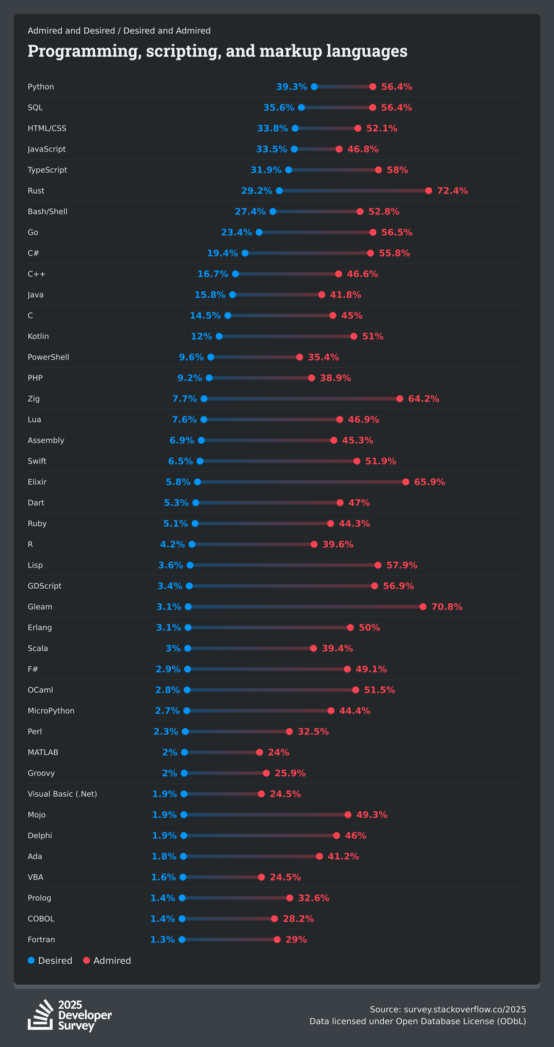

RUST: MOST LOVED LANGUAGE
Which programming, scripting, and markup languages have you done extensive development work in over the past year, and which do you want to work in over the next year?
Source: survey.stackoverflow.co/2025

Slide 6
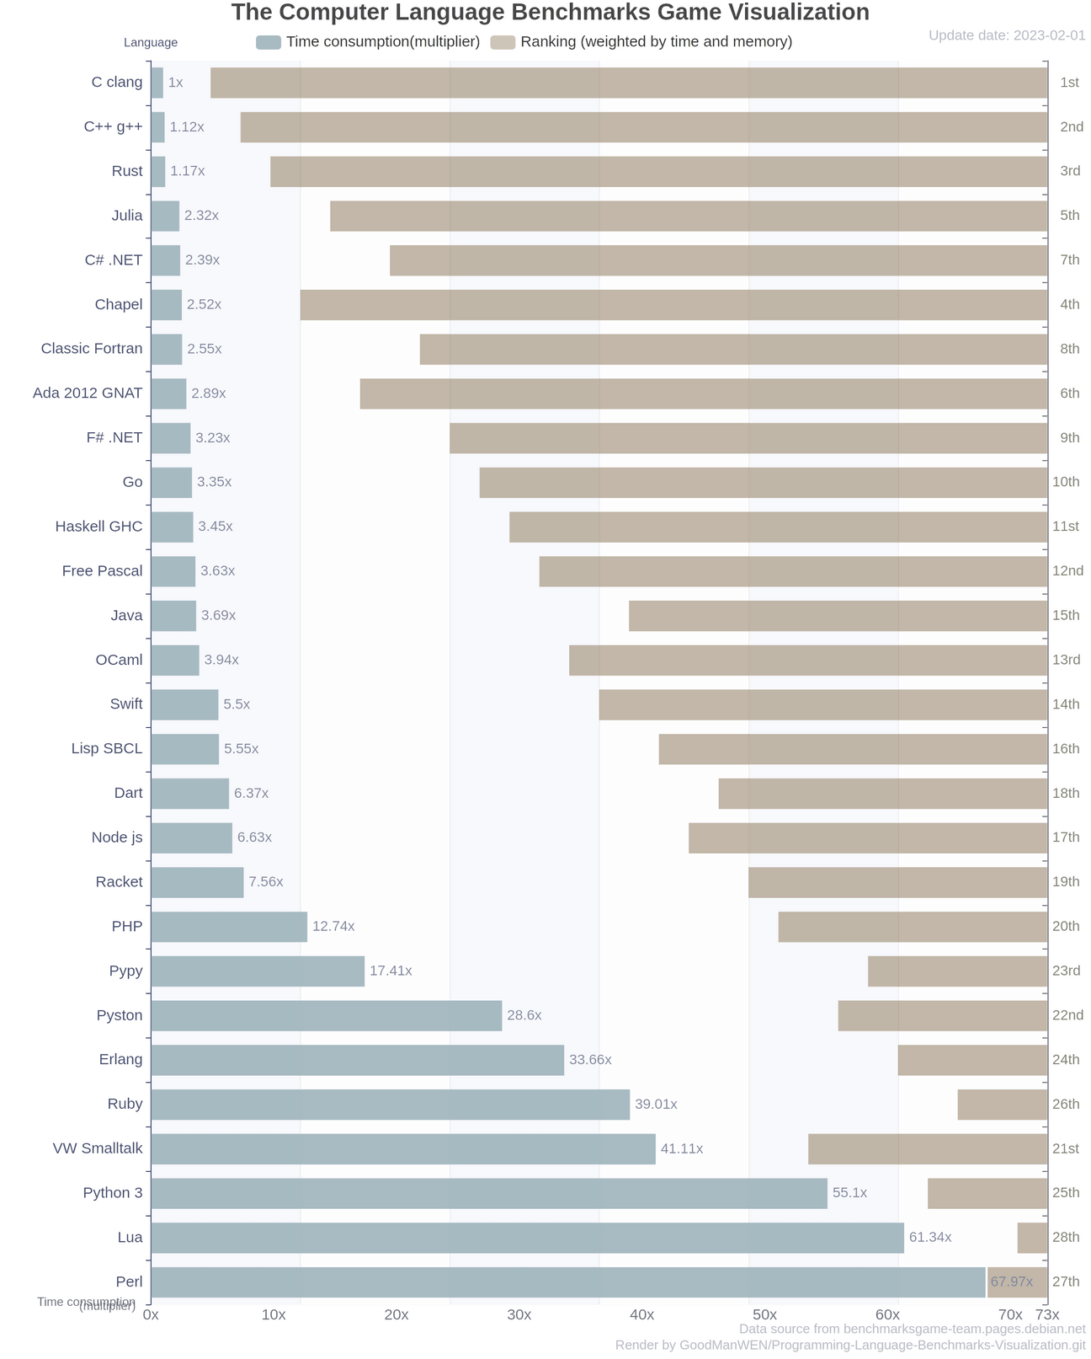
RUST IS AMONG THE FASTEST PROGRAMMING LANGUAGES
Rust ranks 3rd overall in execution time, just behind C and C++.
~1.17× slower than C
Compiled, memory-safe, and no garbage collector
Speed without sacrificing safety.
Source: https://github.com/GoodManWEN/Programming-Language-Benchmarks-Visualization

Slide 7
Operating Systems → Redox OS, Linux kernel modules.
WebAssembly → Faster browser applications.
Blockchain → Solana, Parity.
Networking and Web Servers → Tokio, Actix.
Embedded Systems and IoT devices.
REAL
APPLICATIONS

Slide 8
COMPARISON WITH OTHER LANGUAGES
Rust vs C → Safer memory management with ownership.
Rust vs Go → Better performance, but steeper learning curve.
Rust vs Java → No garbage collector, more control over memory.

Slide 9

RUST SYNTAX
https://github.com/arlemoine/CMPS401/blob/main/Rust/Samples

Slide 10
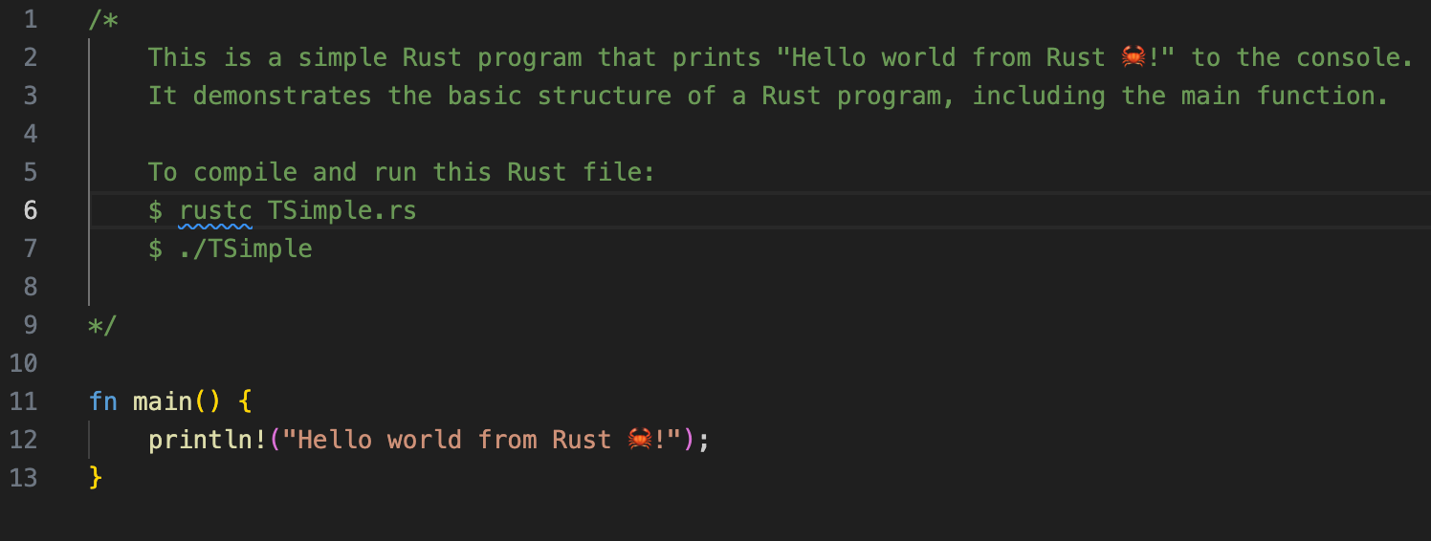
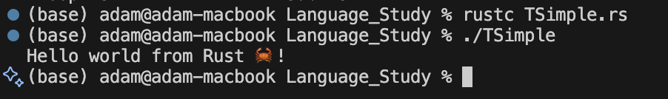
TSimple.rs

Slide 11
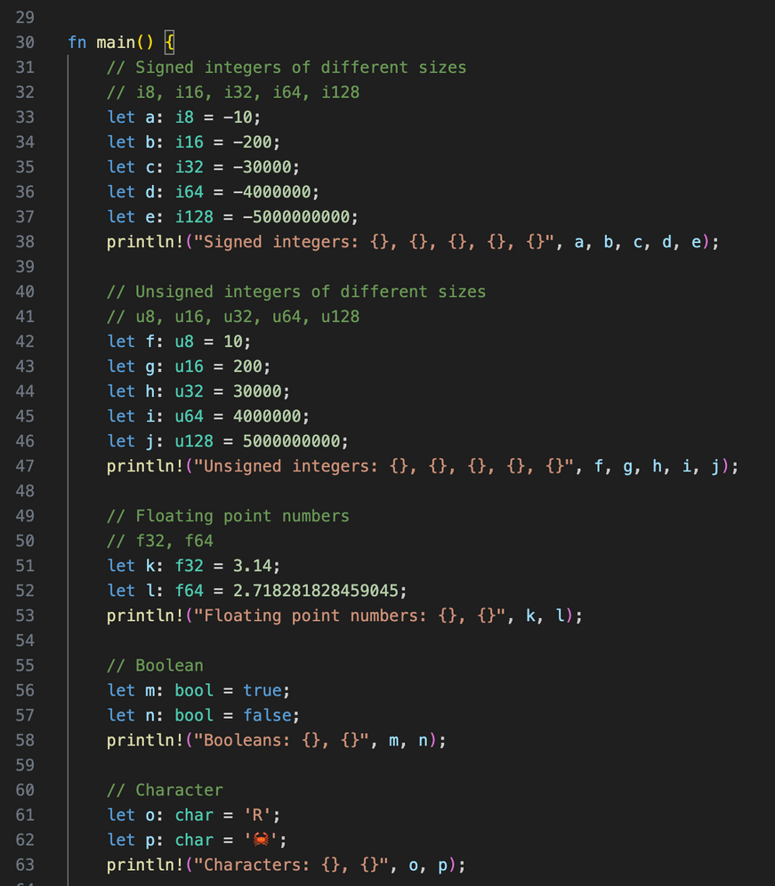
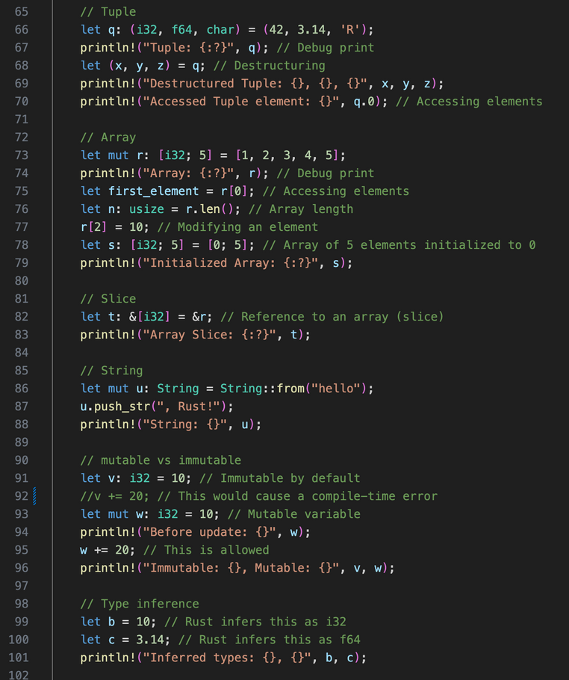
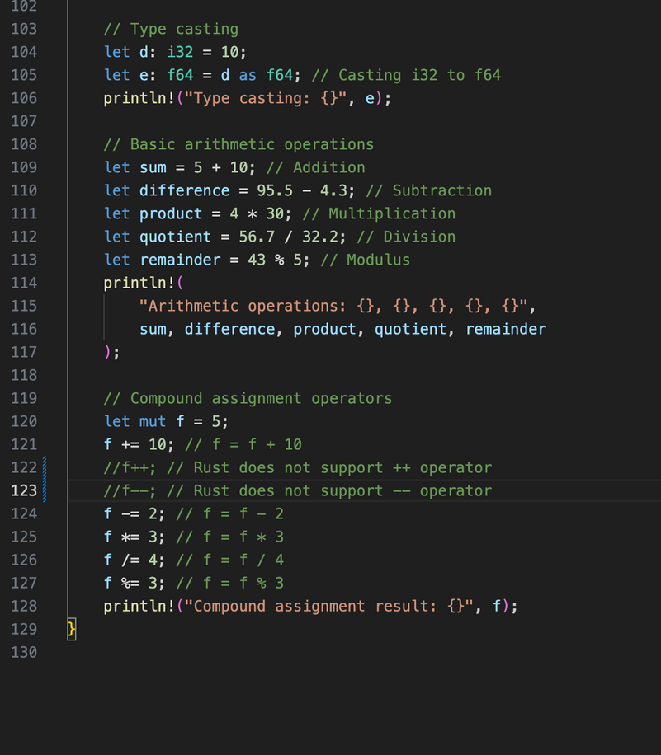
TVar.rs

Slide 12
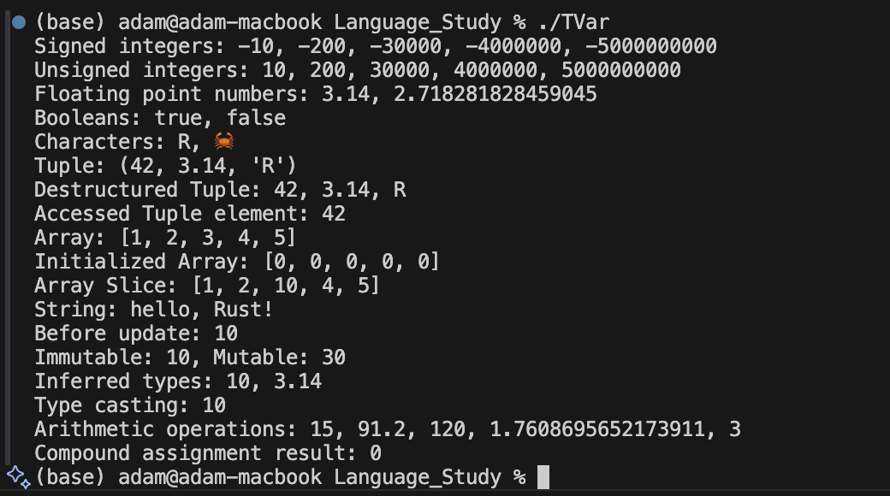
TVar.rs

Slide 13
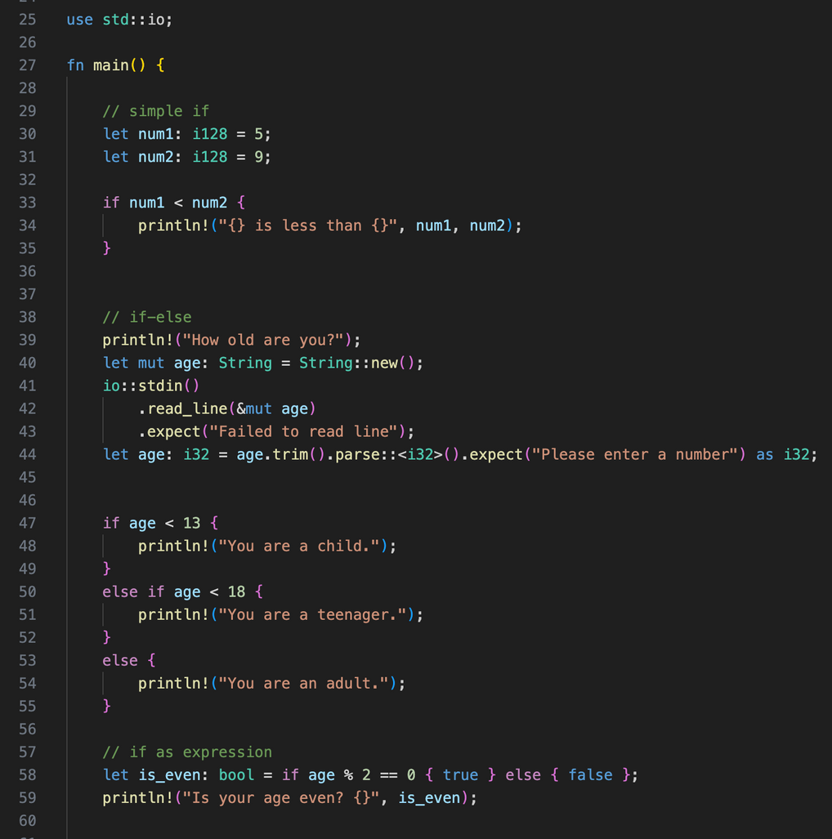
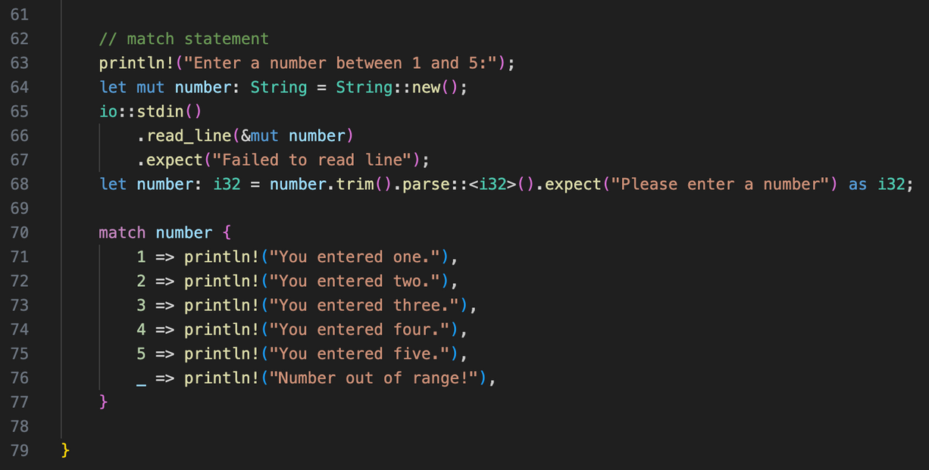
TSel.rs

Slide 14
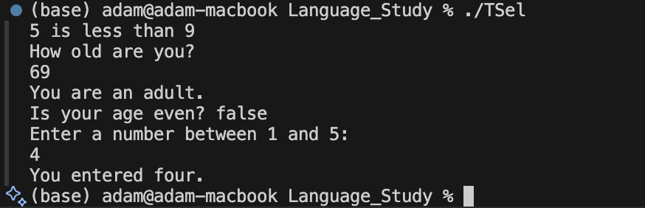
TSel.rs

Slide 15
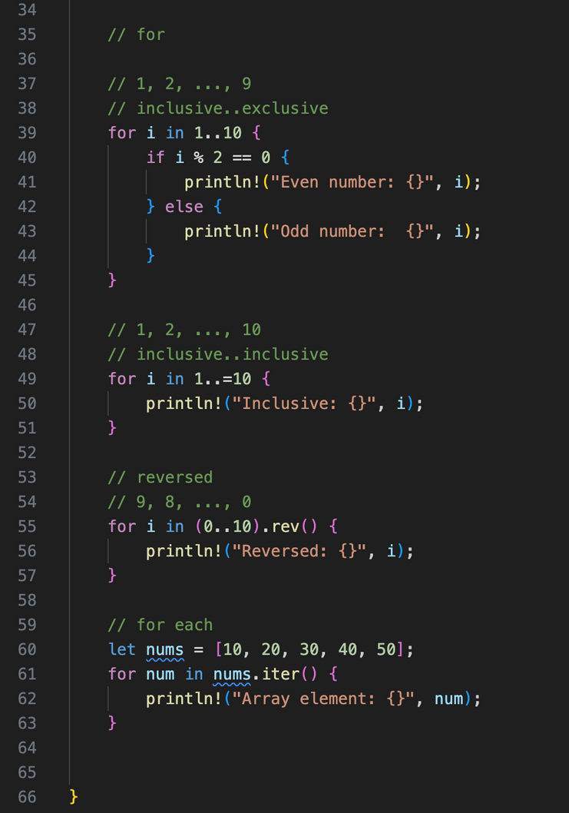
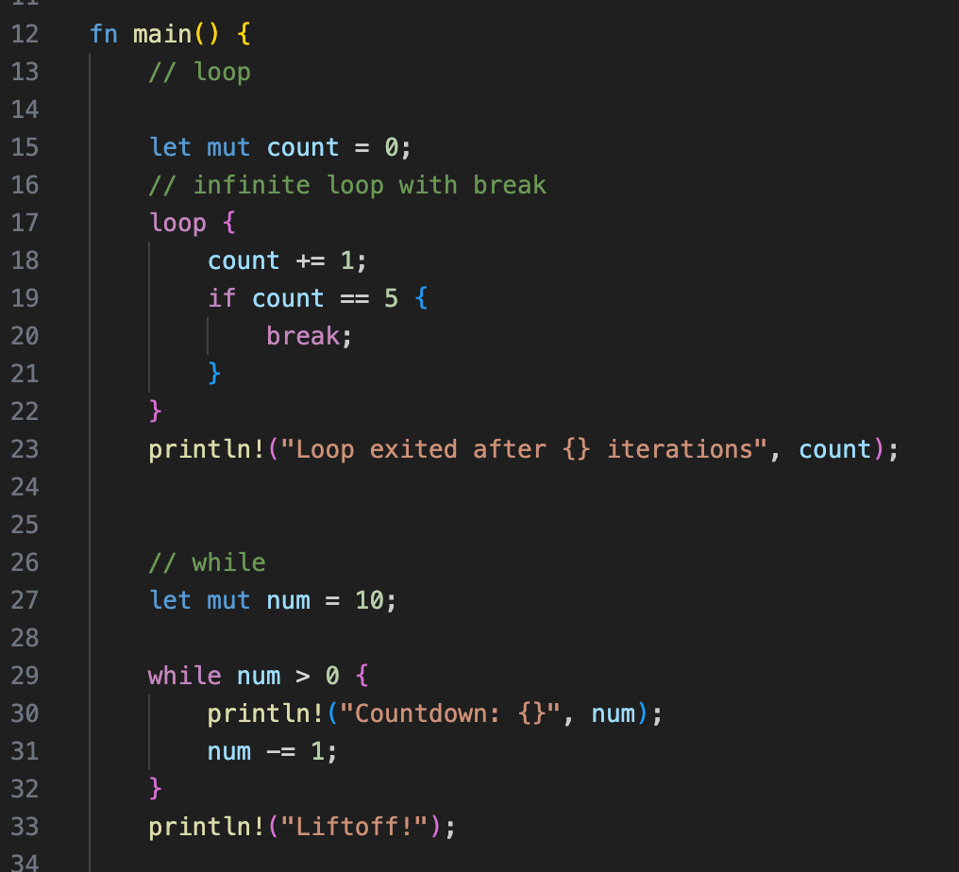
TLoop.rs

Slide 16
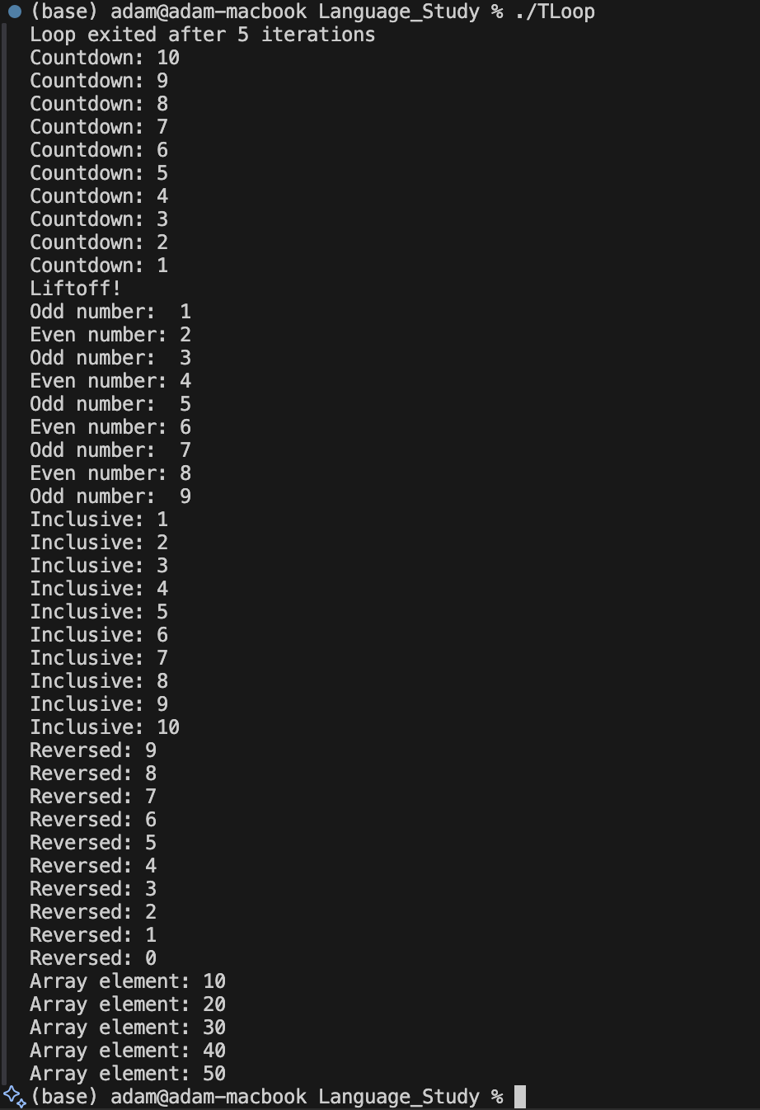
TLoop.rs

Slide 17
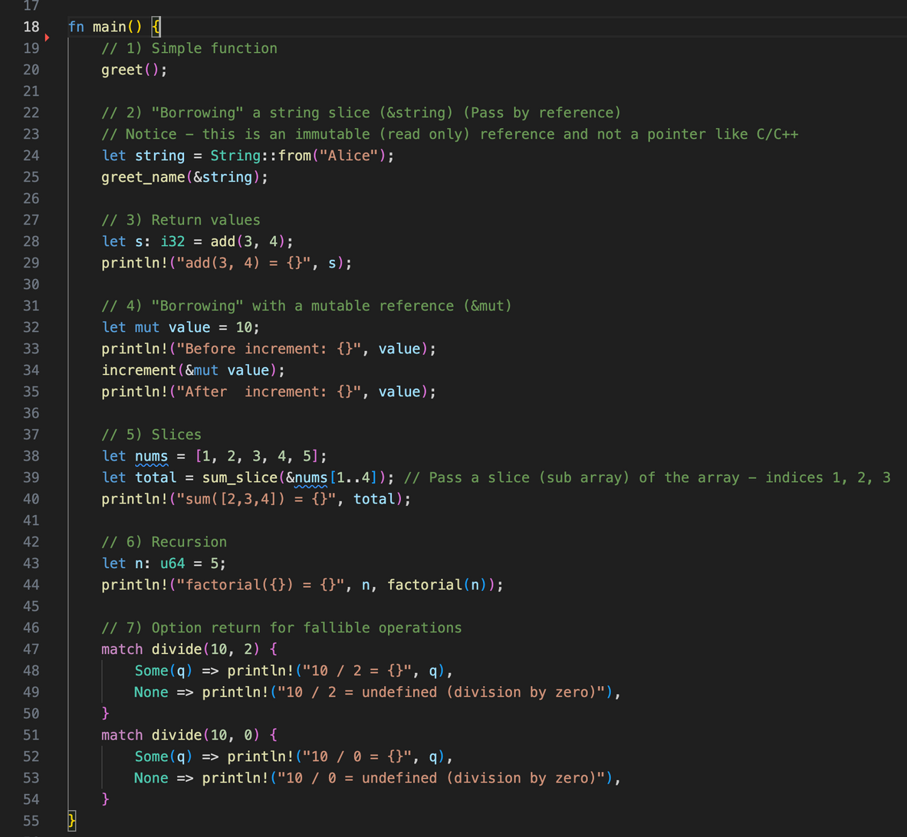
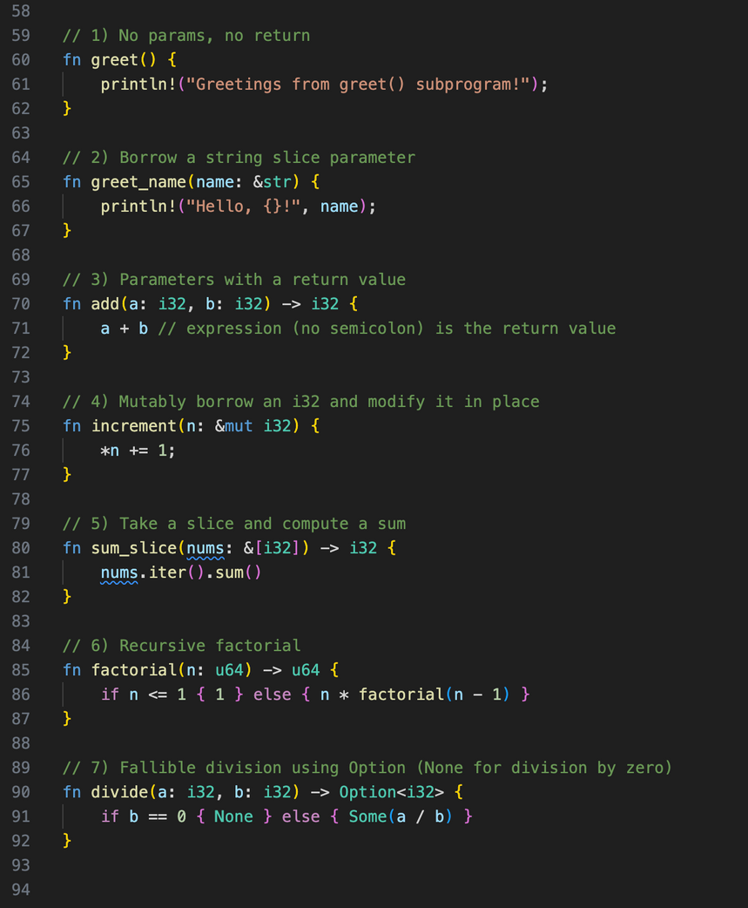
TSub.rs

Slide 18
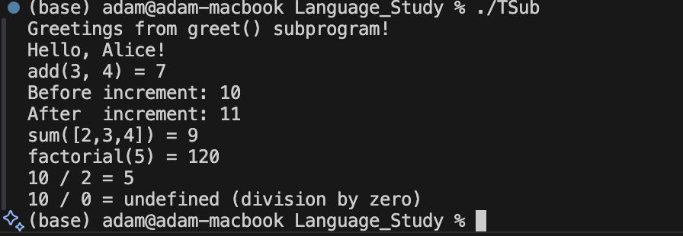
TSub.rs

Slide 19
CHALLENGES &
LIMITATIONS
Steeper learning curve due to ownership and borrowing.
Compilation speed slower than C/C++.
Limited GUI library support.
Smaller ecosystem compared to older languages.

Slide 20
Team SARA
THANK YOU!
References
Official Rust site: https://www.rust-lang.org
Rust Book: https://doc.rust-lang.org/book/
survey.stackoverflow.co/2025
github.com/GoodManWEN/Programming-Language-Benchmarks-Visualization

